Slide 1

SUMMER WORSHIP SCHEDULE
8am – Boardwalk Worship and Communion 11TH street Pavilion
9am – Contemporary Service in the Stainton Room
10:30 – Traditional Worship in the Sanctuary
You can learn more about our worship, ministries, and other events on our website: WWW.MAKINGWAVES.CHURCH
Stop in or contact he church office at: 609-399-2988 or churchoffice@stpoc.org
We invite you to stay connected, grow your faith, and join us in “Making Waves” of difference by sharing Jesus with Ocean City and the world.
08/17/2025

Slide 2


Join us in Worship, Sunday, August 10, 2025
﻿~ with Pastor Erik Hall
Sermon Titled – God Strengthens
Scripture Reading: Philippians 4:10-13
People are frail, imperfect, and easily overwhelmed by the trials and challenges of life. While God doesn't step in and solve all of our troubles, God does promise to give us strength to endure them. When we learn we can do all things through Christ who strengthens us, we find new hope and victory over our trials.

Slide 3

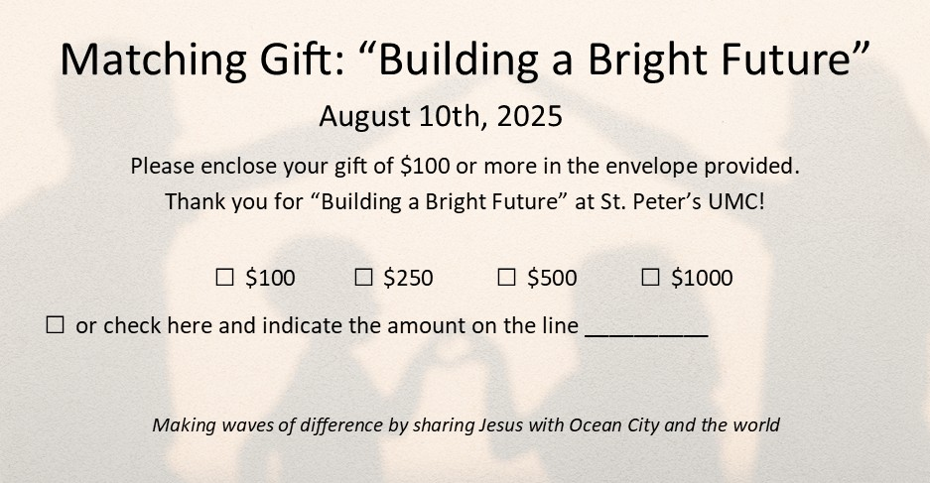
Matching Gift Sunday is this Sunday!

Slide 4

We are looking for a few people to help as ushers for the Traditional service. It's a wonderful opportunity to serve and meet great people.
As an usher you get to be the friendly greeter as people enter our beautiful church. By providing a smile and a warm welcome you may be the reason people return and possibly become members.
We also get to reconnect with our members each week. Presently we have 7 teams which means most ushers are only obliged to serve once every 7 weeks.
If you are willing to join our great group and serve St. Peter’s
please contact Gary Swenson at 609-220-6643.

Slide 5
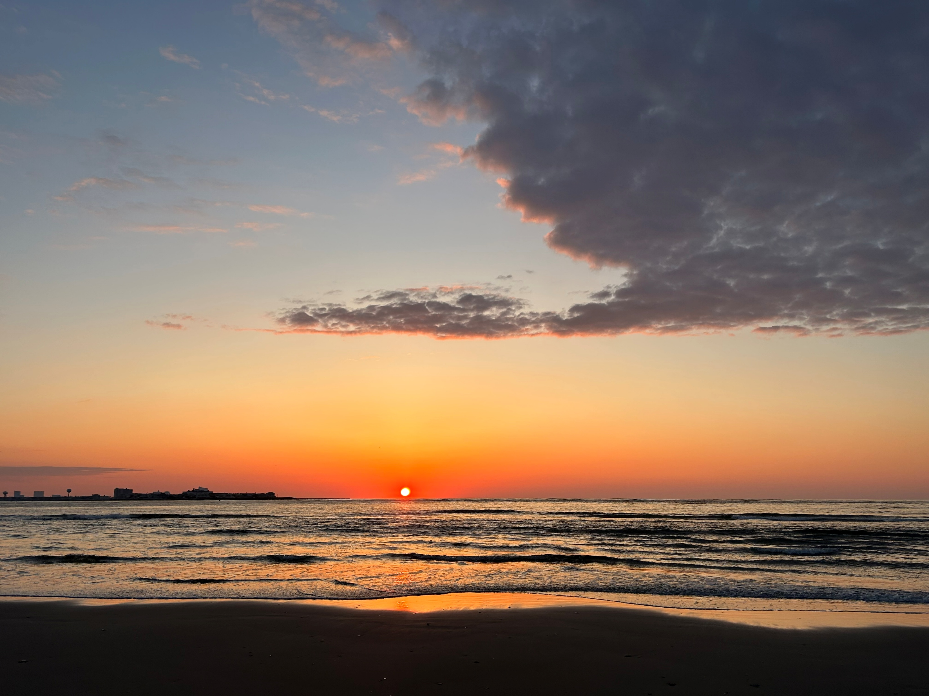
Christian Mindfulness & Meditation
Mondays 9:00-9:30am; Wednesdays 7:00-7:30pm
Location: Northernmost beach in Ocean City
(park in lot on E. Newcastle Rd)
Be still and know that I am God (Psalm 46:10) Our hectic lives rarely seem still. This can lead to stress, distraction, and anxiousness. As we seek to grow in faith, and develop our relationship with God, it is healthy to center our bodies, minds, and spirits daily. Through relaxation, mindful breathing, spiritual music, scriptural reflection, silent prayer, and listening for God learn and practice Christian mindfulness and meditation and become more aware of the divine presence of God in every moment. Contact Pastor Erik (erik@stpoc.org) for details.

Slide 6

Andrea, Marilyn Aishton, The Abbott Family, Abby, Amelia, (Baby)-Jett Ruff, Brandon, Charlie, Huey, Jennifer, Ken&Debbie, Mazie, Nicole, Peter, Megan Atkinson, Lee Allen, Carol Angelo, June Appleton, Jessica B., Matt Bechta, Bill Bender, Melinda Braet, Alice Brown, Bill Z, Ed C., Frank Carlin, Elise Chapman, Donna Chapman, Josie Chivalette, Sean Coleman, Linda Coyle & Family, Bob Cantz, Tina Curione, Penny DaGrossa, Tammy & Analisa Decker, Evelyn DeFazio, Carol DeMill, Larry & Shirley Deming, Shirley Doerrmann & Family, Rosemarie Duncan, Daniel Durkin, Kim Ford, Christa Fries, Denise Gaskill, Emma May Goddard, Frank J. Grass, Eddy Gray, Kim Gremo, Julie Mason Groob, Nick Hand, Clara Hanjian and Family, Chris Harris, Bob Harris, Shirley Haskell, Bob Hill, Katy Hornike, Sharon Hotchkiss, Annie Houdart, Lukasz Hrabski, Kevin Hrtyanski, Sandy Hrtyanski, Bill Hullihen, Ozzie Jordan, John, Judy, Norma Juzwiak, Ron and Pat Kaiser, Ed Kenny, Karen Kenny, Lois King, Constantine Kokkinos, Normalee Linforth, Mike Kubaska, Wayne Maguire, David (Mac) Mascione & Family, Bobbie Mario, Chris Marple, Don Marple, Kenny Marple, Wanda Marple, Melinda Mayne, David Mason, Paul M., Bill McCord, Helen McNamara, Vic M., Olga Messina, Helen Miller, Al Nicolosi, Bernice Nolte, Tracey O'Brien, Peggy & Steve Oden, Charlene Oldfield, Marianne Oliver, The Ostien Family, Eleanor Parker, George Pierpoint III, Gail Poholsky, David Powell & family, Haley Raineer, Sandra Rigg, Joan Robertson, Zacci Robertson, Barbara & Joe Rodrigues, Rev. Edward Rusk, Gloria S., Margaret Schock, Jillian Schoenstein, Carol Schoff, Joe Skultin, Barbara Smith, Robin Smith, Jacob Snow, Manfred Stahl, Spear Family, Swen Swenson, Ken Thorpe, Bob Vallerschamp and Family, Pauline Wallace, Dawn Wassinger, Lois Werner, Bill Woods, all people with cancer diagnose; and all unspoken requests.

Slide 7

Save the Date!!!
St. Peter’s United Methodist Church
Annual Golf Outing benefitting St. Peter's Missions
"FORE GUATEMALA"
being held at
Heritage Links Golf Club
1375 Rt. 9, Ocean View, NJ
Saturday, September 20, at Noon!

Slide 8

MUSIC AT 11....
Ok, here's an idea for you! Have you ever thought about singing in the choir? Well, if you have come join us and if you haven't you should!
Our choir is made up of 28 volunteer singers who all bring a gift with them every time we gather. Like the gifts under a Christmas tree these gifts are all wrapped differently and are different sizes. Everyone is equal in the choir.
During the summer we meet at 9:30am on Sunday and sing at 10:30. Starting in September we will rehearse on Friday at 6:00pm and sing at 11:00am on Sundays.
So, you can't be there every week? No one can.... So, you cannot sight read. Everyone's "reading" abilities are all different. Just like the first time you went in the water to learn to swim.... Trust me, you learned then and you will learn now too. Be patient and give it time....
So, have I convinced you yet? Hmmm... when you see a choir member ask them about being in the choir!
See you at church!
* * * *
Masterworks Choir is looking for you!! Rehearsal: Wednesdays at 6:30pm
Summer Concert: August 6th at 7:30pm
Come and Sing!!!

Slide 9
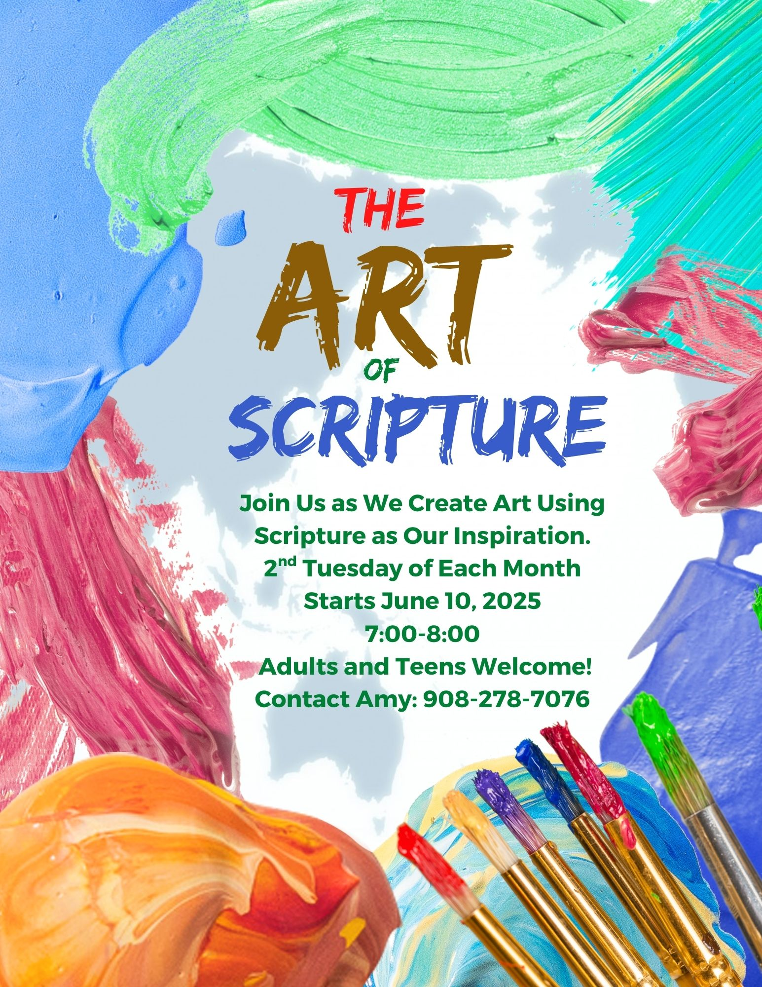

Slide 10
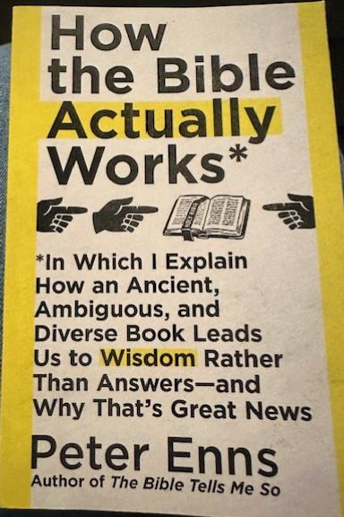
Have you ever wondered how the Bible actually work?
Author and Biblical Scholar, Peter Enns,
has just the book for you!
    How the Bible Actually Works
    Thursday’s at 10am in the Fox Room
    Meeting Dates are: 6/26, 7/10, 7/24, 7/31, 8/14, 8/28
In Which I Explain How an Ancient, Ambiguous, and Diverse Book Leads Us to Wisdom Rather Than Answers—and Why That’s Good News!
What a mouthful for a book title! But it describes exactly what this study will help us to discover.
Come and join us in the Mary Marr Room for a lively, faith-deepening discussion.
Books are available in the church office or speak to/call/email Pastor Kathleen to get a copy.

Slide 11
What is your Spiritual Biography?
The stories of our experience of God can inspire and comfort others. Many of you have travelled over a lifetime with Christ as Savior, Healer, Friend. What is your story?
Beth Mallozzi is collecting stories by visiting with you. Within the church, our spiritual stories are diverse as our unique fingerprints. Outside the church, there are many people seeking the divinity of God in a diversity of ways as well. Others are simply wondering if God is there at all.
The trials of our faith journey may point to potential growth for us in new ways unforeseen. These stories include fear, disappointment, anger and betrayal. Paul Tillich, a great theologian from the early 20th century wrote, “If you’ve never run away from your God, I wonder who your God is.” What are your unresolved spiritual yearnings? Where is God showing up for you?
If you are willing to share your story, Beth will love to hear it. If you’d like to keep your story confidential to her, she will protect that confidentiality. These stories will be compiled over time, and with your permission, shared at some point, in some way to be determined.
Please contact Rev. Beth Mallozzi by phone, text or email if interested in sharing your story.
302-745-9904, beth.mallozzi@gmail.com

Slide 12

List Continued from Front Side:
Black Painters Tape (We need a lot of rolls)
Spray Water Bottles (new or used) for our craft station
White Poster Board
Food Items:
We will have around 130 children attending our VBS. We will need enough of the following food items to provide snacks for each of them.
*Oreo Cookies: big family size packages
*Bags of Pretzel Sticks
*Individual Snack Size Plain Lays Potato Chips
Thank You Church Family!
Donation List
We created an Amazon Wish List for specific items. Email Amy (amy@stpoc.org) to have the link shared with you.
We are preparing for around 130 children. We will need many units of each items listed below.
*Amazon Gift Cards
*Old Maps (any you have around the house and do not want anymore)
*Round Plastic Table Cloths: red, green, bright yellow
*Rectangle Table Cloths: all colors (big needs: deep blue, red, bright yellow)
*Streamers (Crepe Paper): red, green, bright yellow
*Foil Fringe Curtain (all colors)

Slide 13
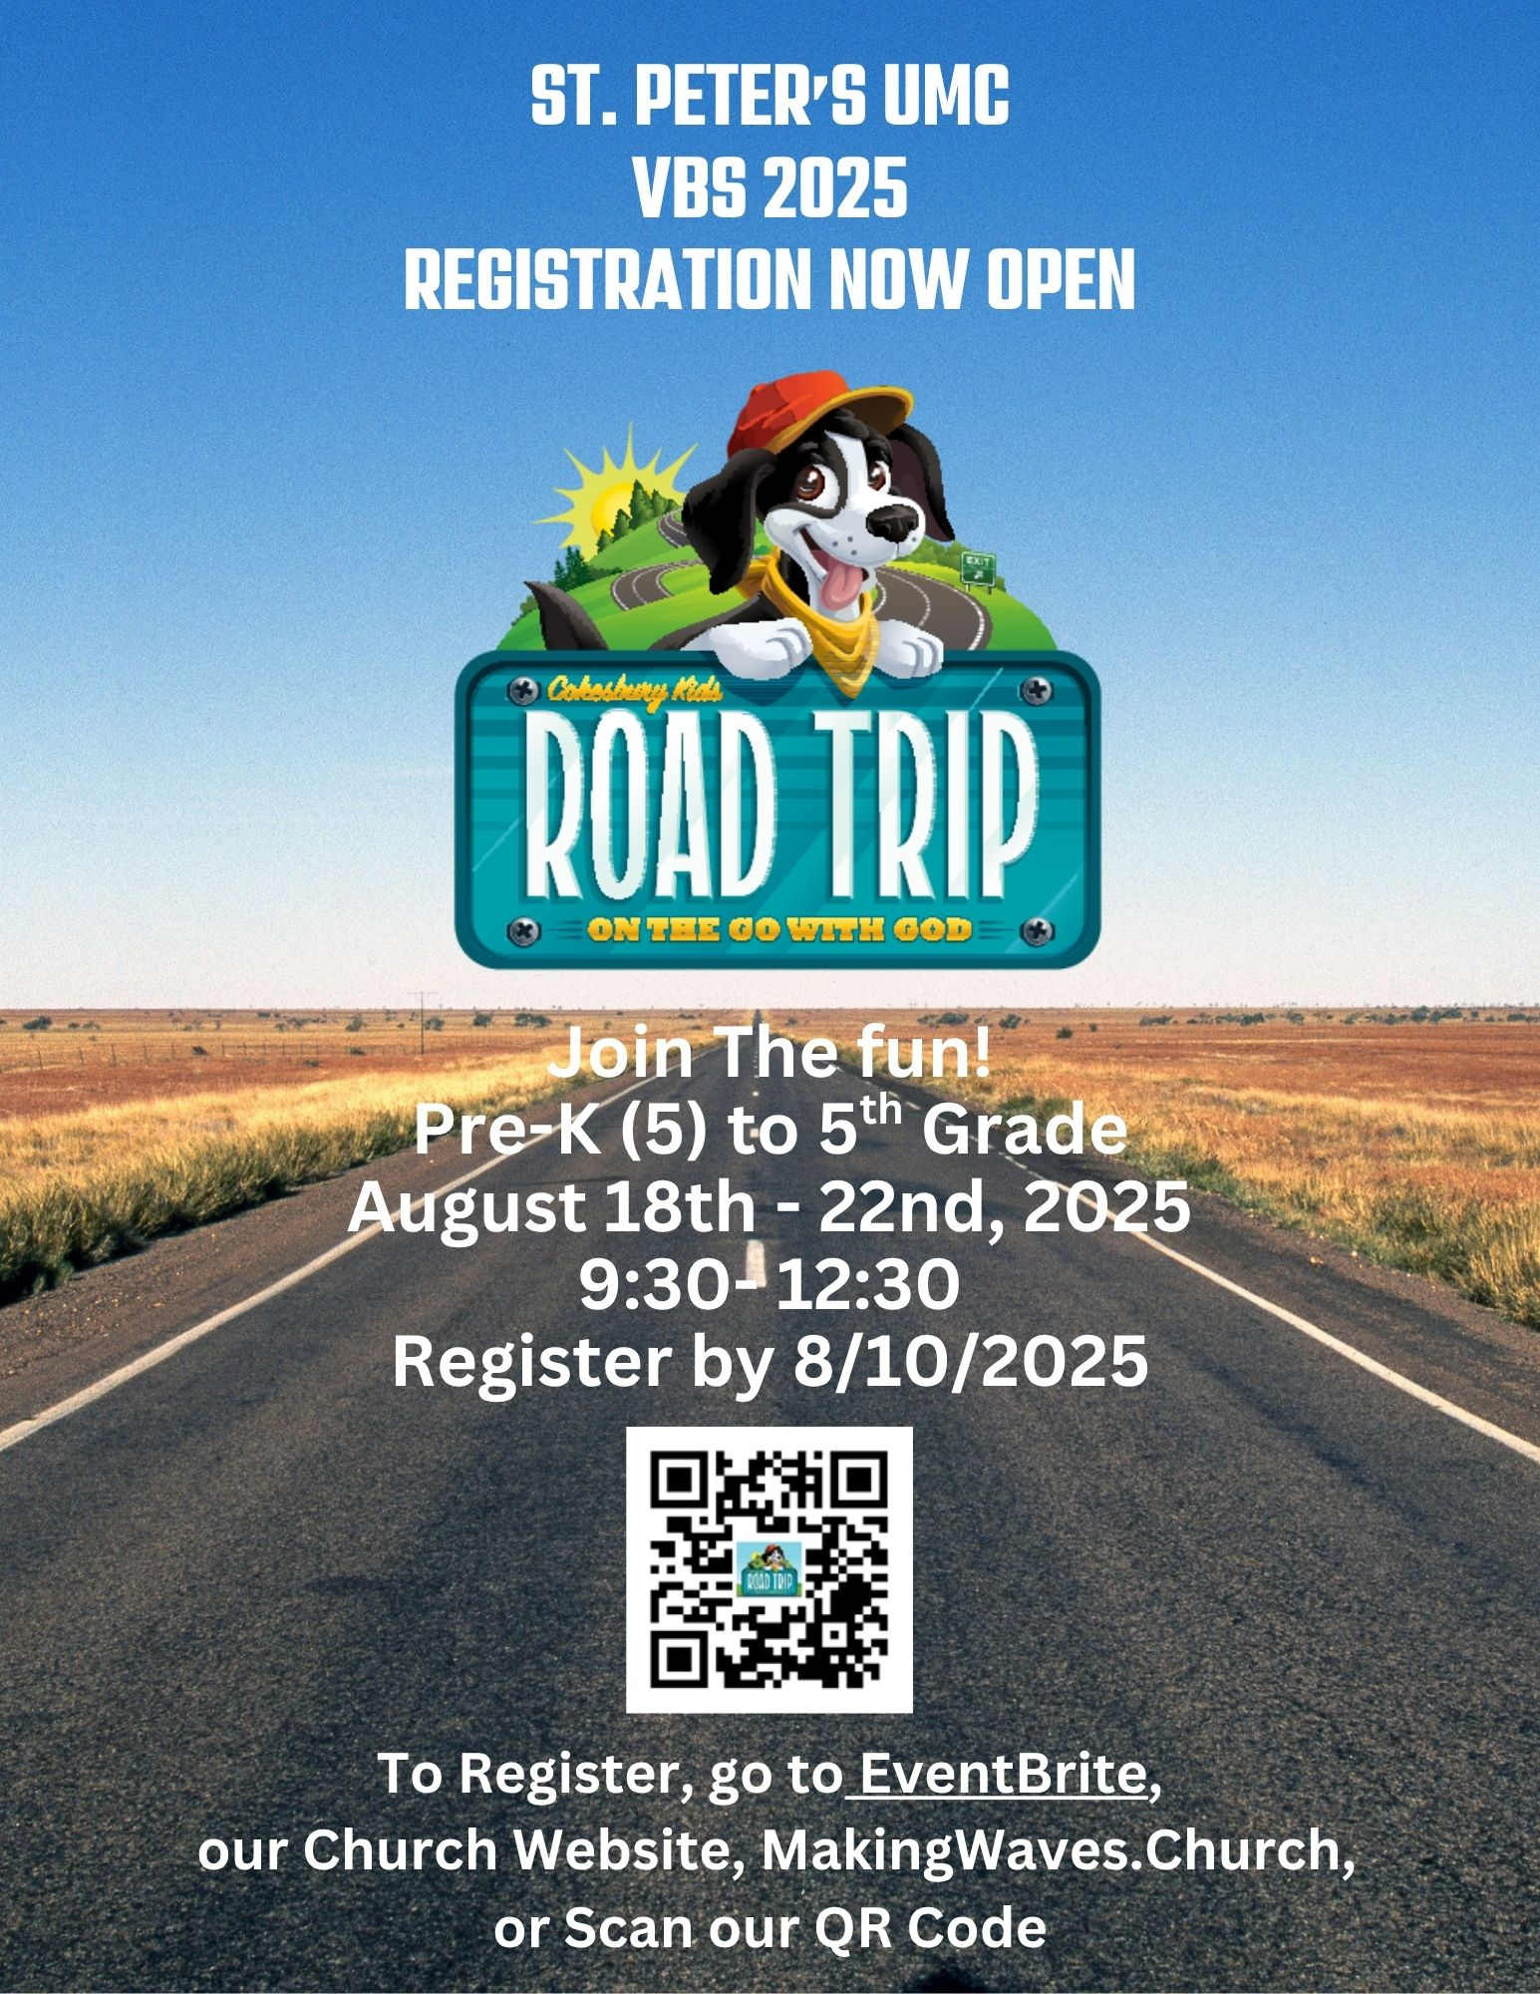

Slide 14


Slide 15


St. Peter’s Hospitality Committee
St. Peter’s Hospitality
Volunteers Needed To:
Prepare Meals
Deliver Meals
Be a Calling Captain
Call the office for more info!
609-399-2988

Slide 16
St. Peter's UMC
WOMEN'S BOOK GROUP
~ App and Chat ~
THIS MONTH'S PICK . . .
The Storied Life of A.J. Fikry
By: Gabrielle Zevin
August 25, 7pm to 8pm
We'll enjoy an APPetizer as we chat about great books!
Email Amy with any questions: amy@stpoc.org

Slide 17


Slide 18
TAI CHI
MONDAY, WEDNESDAY, & FRIDAY’S
9:30 - 10:30 AM
LOCATED ON THE THIRD FLOOR.
ALL ARE WELCOME!
FOR INFORMATION EMAIL GINNY AT V.STRANG@ICLOUD.COM

Slide 19


Slide 20
Grief Support Group Meeting
Our group meets every other Tuesday from 6:30pm to 8pm.
The group is open to all adults who are grieving the death of a loved one.
For more information call Jane Taylor 609-412-1855 or email: Janeht927@yahoo.com
Next meeting: Tuesday, August 19, 2025
Where: St. Peter's UM Church
Please spread the word that we are holding space for everyone and their grief.
I always say: “I’m sorry you are here, but I’m glad we are here for you.”

Slide 21
Called to Care
One of the important ministries of St. Peter’s UMC throughout the years has been the visitation ministry.
This vital outreach to our members and friends by making “check in” calls and visits has served to express our care and support.
If you would like to be a part of this group of visitors please call the church office (609-399-2988) or contact
Pastor Kathleen (609-432-2726) or email her at kathleen@stpoc.org to express your interest.

Slide 22

METHODIST MEN'S MINISTRY
We are Ready and available to volunteer for whatever projects you may have!!!
Just give Keith Hartzell a Call at 609-289-1484
Veterans Coffee Club (aka)
"A Cup of Joe"
Saturday, August 16, 2025, at 9am
Enjoy coffee, pastries, and fellowship with other veterans who meet on the first and third Saturday of each month.

Slide 23

AA Meetings Held at St. Peter's UMC
Monday through Saturday from 7:30am to 8:30am
In Room 121

Slide 24
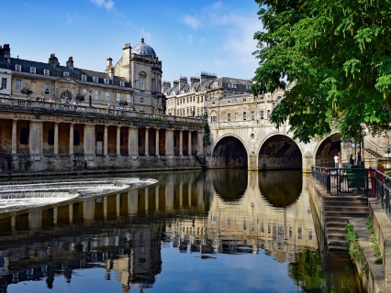
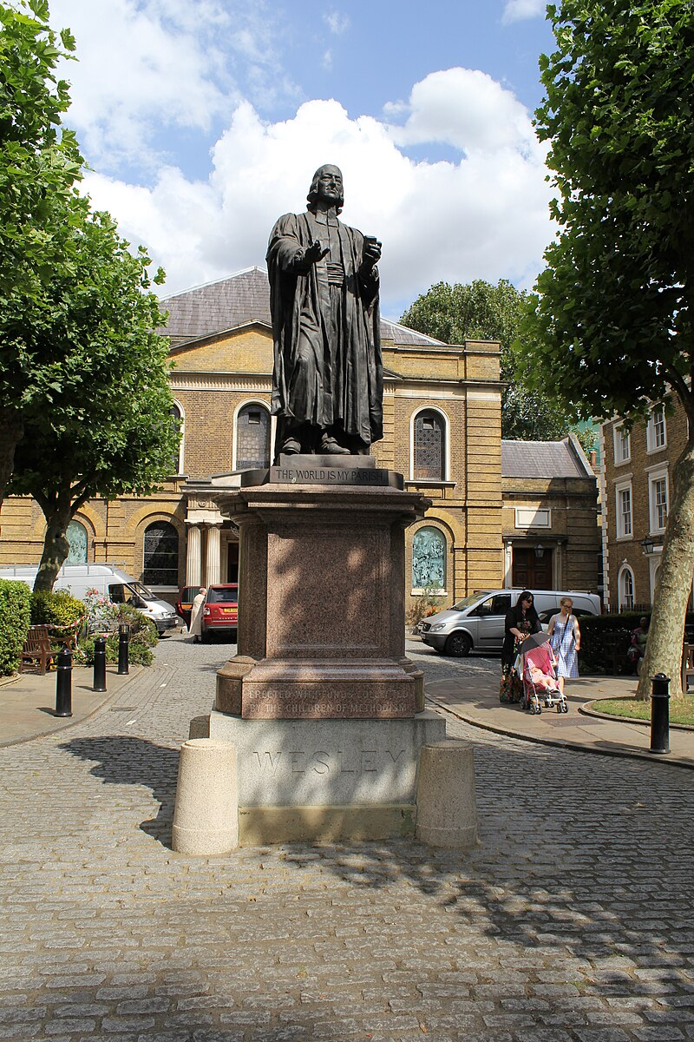
Travel in England and pilgrimage to Wesley sites!
Join St. Peter’s for a faith, fun, and fellowship filled
10-day trip to England!
The dates are October 10th - 19th, 2025.
Led by the Rev. Dr. Bob Williams (former general secretary of the united Methodist commission on archives and history) and Rev. Erik Hall (lead pastor at St. Peter’s UMC in Ocean City), we will visit sites important in the life of John and Charles Wesley and our Methodist heritage. Be inspired by seeing John Wesley's prayer room in his home in London, visit the church in Epworth where he was baptized, his family home, and worship in the chapel he had built in London. Also, travel will take us to the tower of London, the Cotswold's, Shakespeare's home, Coventry cathedral, Oxford University and Bath (a city of roman origin).
Trip cost will be $3998 and includes airfare, first-class hotels, deluxe motorcoach, taxes, tips, and entrance fees, and most meals. Go to: makingwaves.church to download a brochure and register, or contact Pastor Erik.

Slide 25

EQUAL EXCHANGE - Fairly Traded
Organic Chocolate and Coffee for Sale!
Visit the Mission's Team chocolate and coffee cart to purchase a variety of delicious flavors and blends! All grown by Small Farmer Co-ops! All proceeds benefit St. Peter's Missions!
Coffee $12 or (2) for $20 - Chocolate Bars $6 or (2) for $10
Checks payable to: St. Peter's UMC
Mission's General in memo Line or exact cash.
Thank you so much for your support!

Slide 26
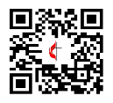


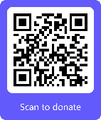
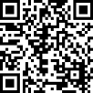
TITHES AND OFFERINGS You can send in checks to 501 E. 8th Street, Ocean City, NJ 08226 or donate online via the church website: makingwaves.church NEEDS? Please contact the church office at 609-399-2988 if you need food or assistance. St. Peter's invites you to stay connected, grow your faith and "Make Waves" of difference in this hurting world. CHURCH OFFICE HOURS ﻿Regular Office Hours: Monday through Thursday 9am to 3pm; Friday 9am to Noon
Website Facebook Venmo Wallets General

Slide 27
Welcome Friends!
At the ‘Making Waves Church’ we are growing in faith, hope, and love as we follow Jesus in ministry and mission. Maybe you have been looking for God, and you sense God’s presence here in our midst. Maybe you are new to the city and are looking for a church home. Maybe you are looking to reconnect with your faith. The important thing is that you are here, Jesus loves you, and maybe God has a plan for us to journey in faith and life together!
Take a moment to connect with our pastors, staff, greeters, or church leaders today and let’s get to know each other. You can also contact Pastor Erik Hall during the week.
We are excited for all God is doing and we look forward to seeing you again at
St. Peter’s UMC

